Slide 1
EPICS on the Web:
Modernizing graphical user interfaces
Author: Jiří Švácha
Visit to Harwell Science and Innovation Campus, February 5–6, 2025
Date:
31.01.2025

Slide 2
Agenda
Introduction
Vision: EPICS for the Web
Architecture Overview
Tech-stack
Examples
Future
Conclusion

Slide 3
Introduction
HMIs as an essential component for successful operation
Current situation at ELI – Beamlines
Motivation for change

Slide 4
Introduction
HMIs as an essential component for successful operation
Current situation at ELI – Beamlines
Motivation for change

Slide 5
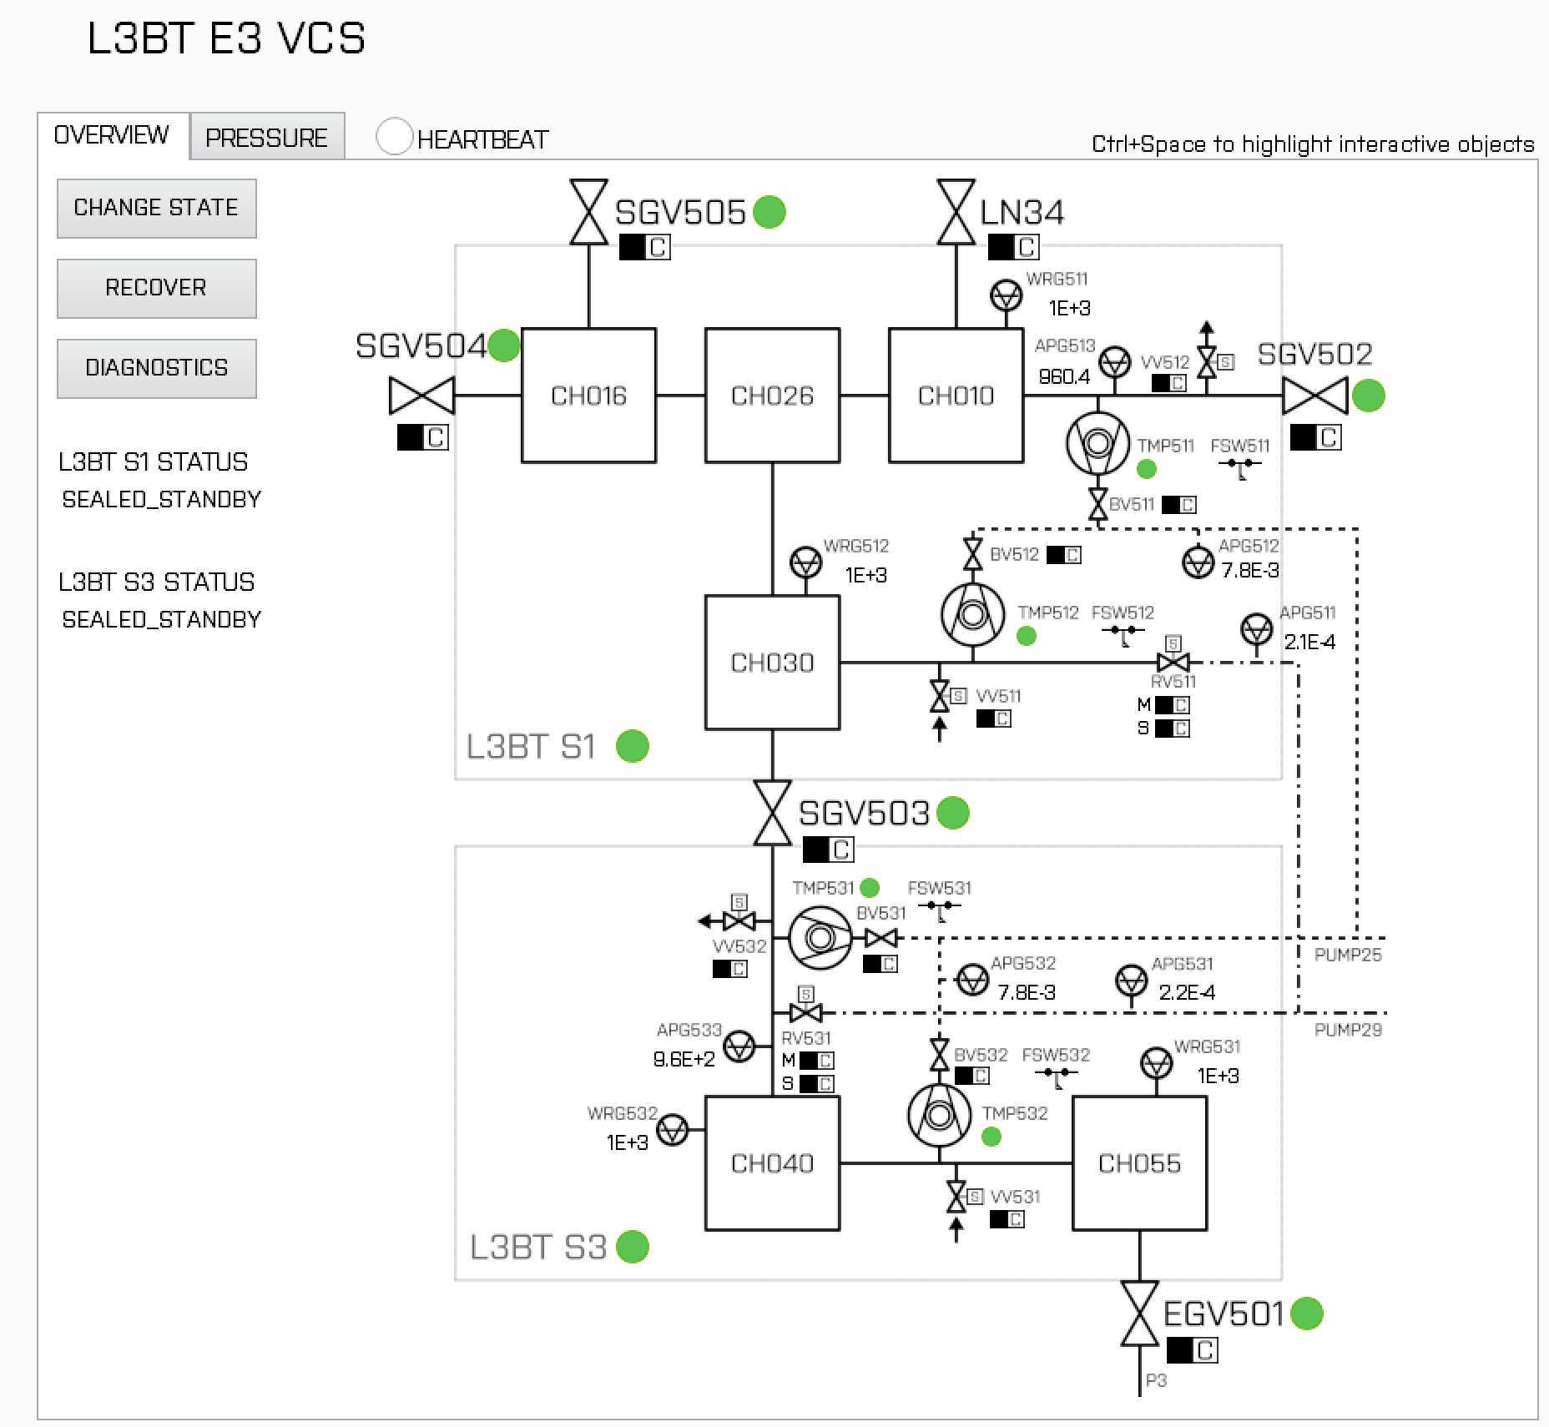
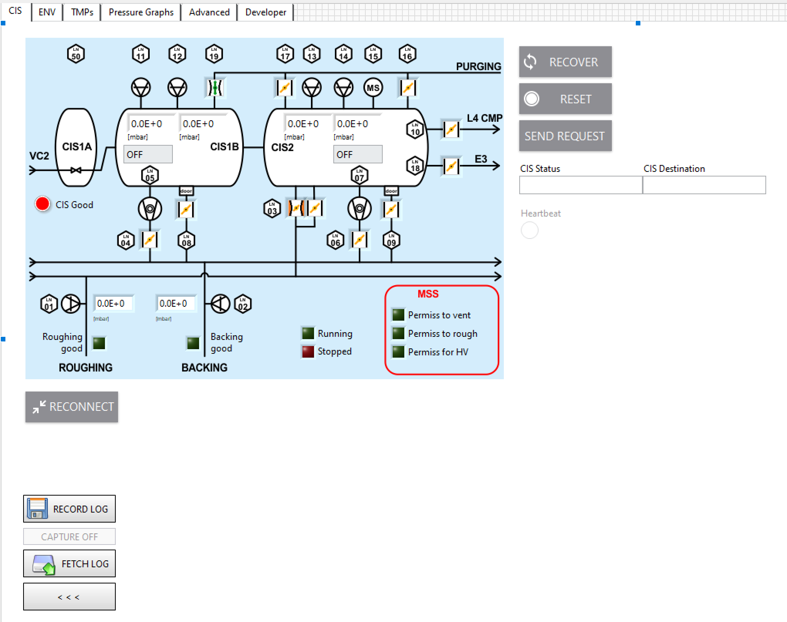
Introduction
Current situation at ELI – Beamlines

Slide 6
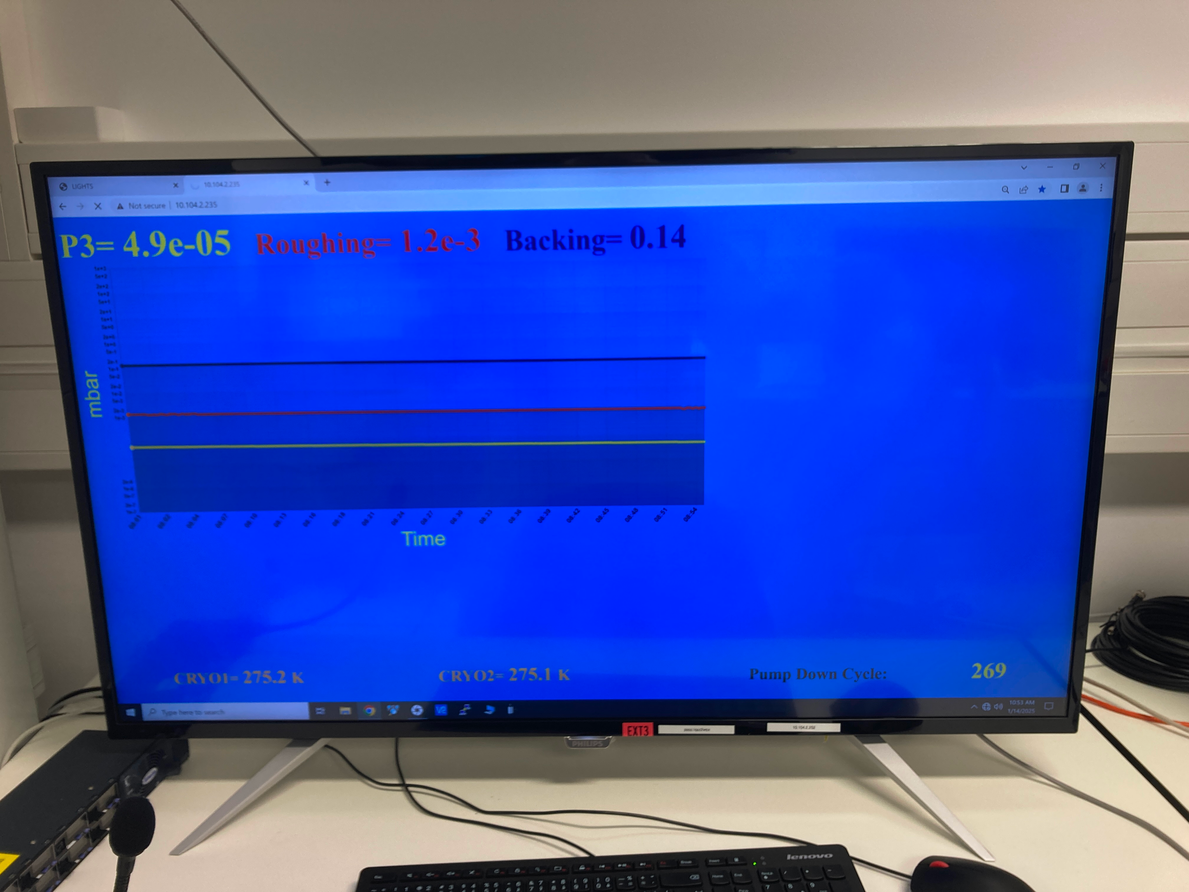
Introduction
Current situation at ELI – Beamlines

Slide 7
Introduction
HMIs as an essential component for successful operation
Current situation at ELI – Beamlines
Motivation for change

Slide 8
Introduction
Motivation for change
Standardisation
LabView limitations
Deployment process
Authentication
Limitation of control from multiple locations at once
UX Designer

Slide 9
Introduction
Motivation for change
Standardisation
LabView limitations
Deployment process
Authentication
Limitation of control from multiple locations at once
UX Designer

Slide 10
Introduction
Motivation for change
Standardisation
LabView limitations
Deployment process
Authentication
Limitation of control from multiple locations at once
UX Designer

Slide 11
Introduction
Motivation for change
Standardisation
LabView limitations
Deployment process
Authentication
Limitation of control from multiple locations at once
UX Designer

Slide 12
Introduction
Motivation for change
Standardisation
LabView limitations
Deployment process
Authentication
Limitation of control from multiple locations at once
UX Designer

Slide 13
Introduction
Motivation for change
Standardisation
LabView limitations
Deployment process
Authentication
Limitation of control from multiple locations at once
UX Designer

Slide 14
Vision: EPICS for the Web
Use modern web technologies
Web Server as an EPICS Web Gateway
Web Client as a lightweight HMI
Easy deployment

Slide 15
Vision: EPICS for the Web
Use modern web technologies
Web Server as an EPICS Web Gateway
Web Client as a lightweight HMI
Easy deployment

Slide 16
Vision: EPICS for the Web
Use modern web technologies
Web Server as an EPICS Web Gateway
Web Client as a lightweight HMI
Easy deployment

Slide 17
Vision: EPICS for the Web
Use modern web technologies
Web Server as an EPICS Web Gateway
Web Client as a lightweight HMI
Easy deployment

Slide 18
Architecture Overview
ca monitors
websocket connection
EPICS
Web Server - Gateway
Web Client – Web App - HMI
Smart
PVs to Channels Provider Service
One Place
Operations
Limiter
Service
Auth
Service
WebSocket Provider Component
Register to provider
HMI Component
Provide
PVs
changes
HMI Component
HMI Component

Slide 19
Tech-Stack
Server side: Python, FastAPI, aioca
Client side: Web Components, TypeScript

Slide 20
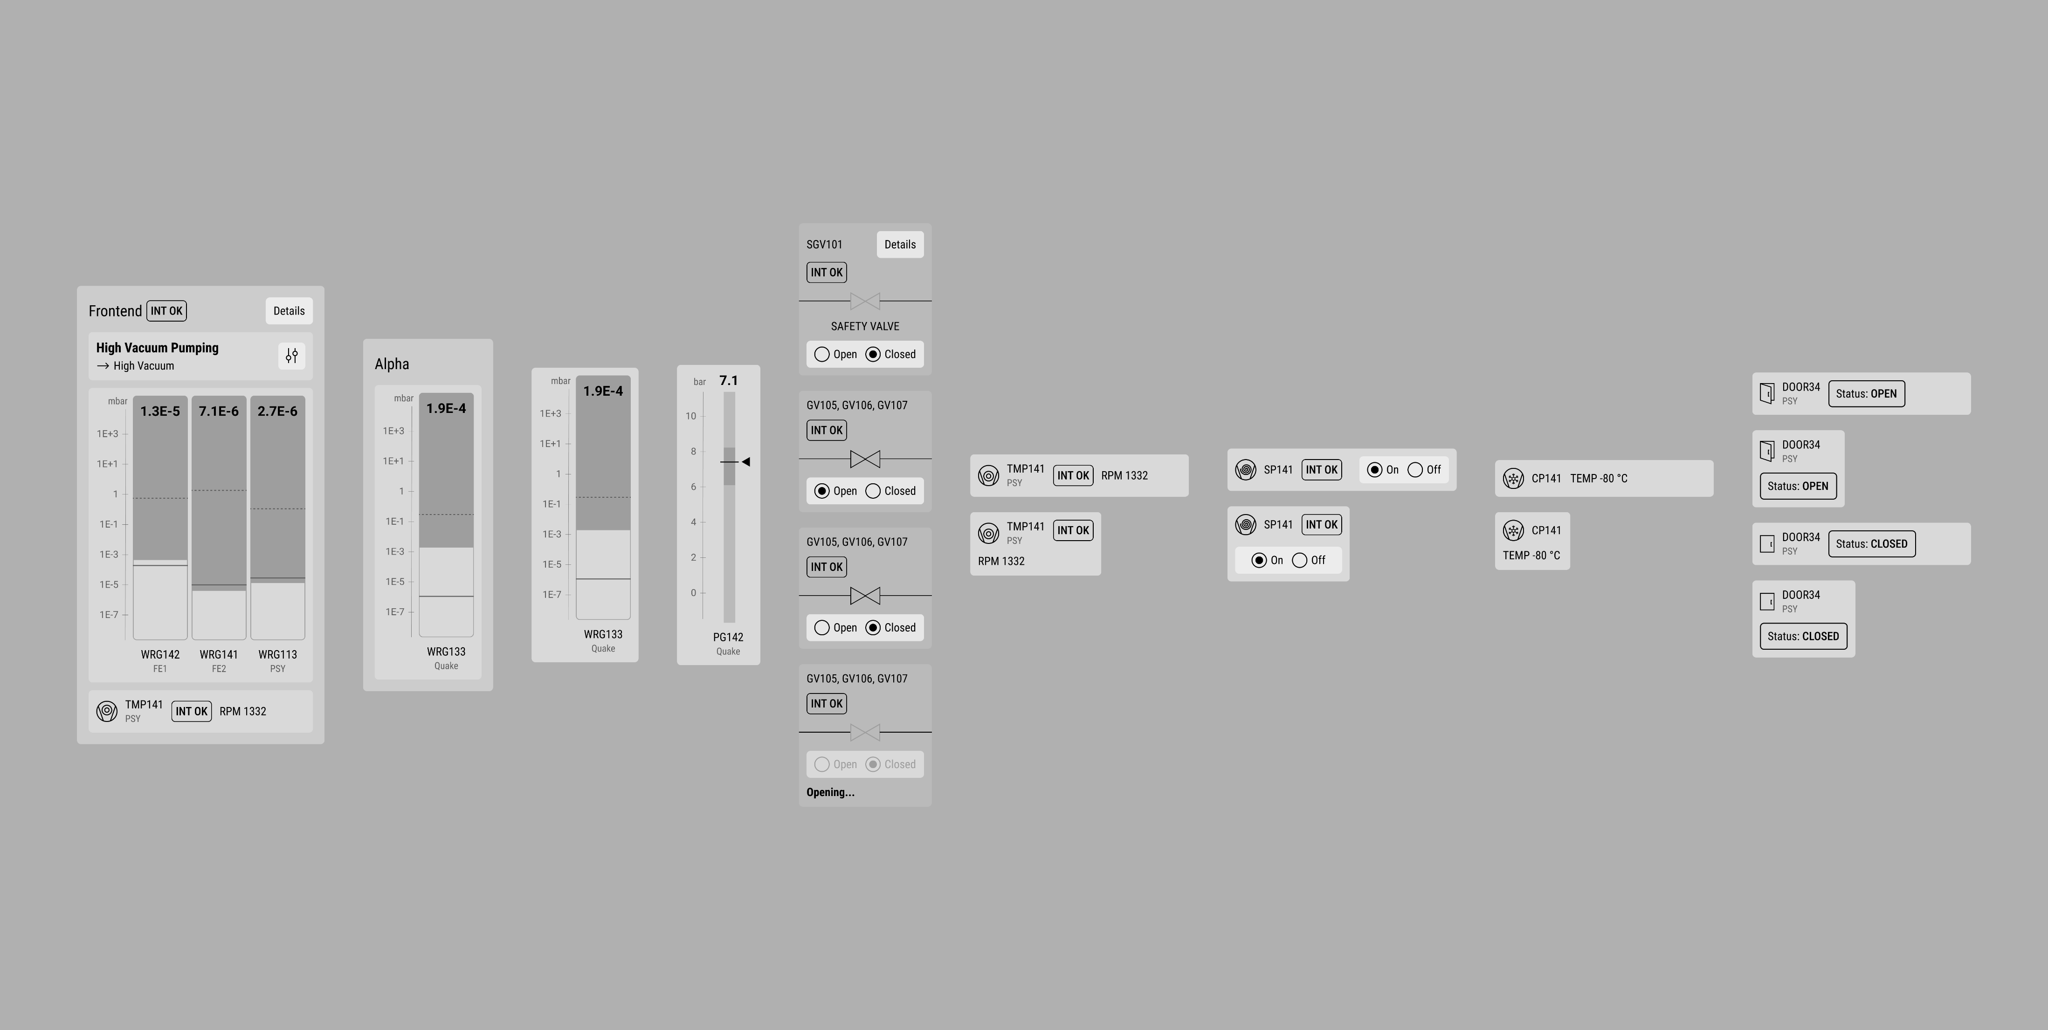
Examples

Slide 21
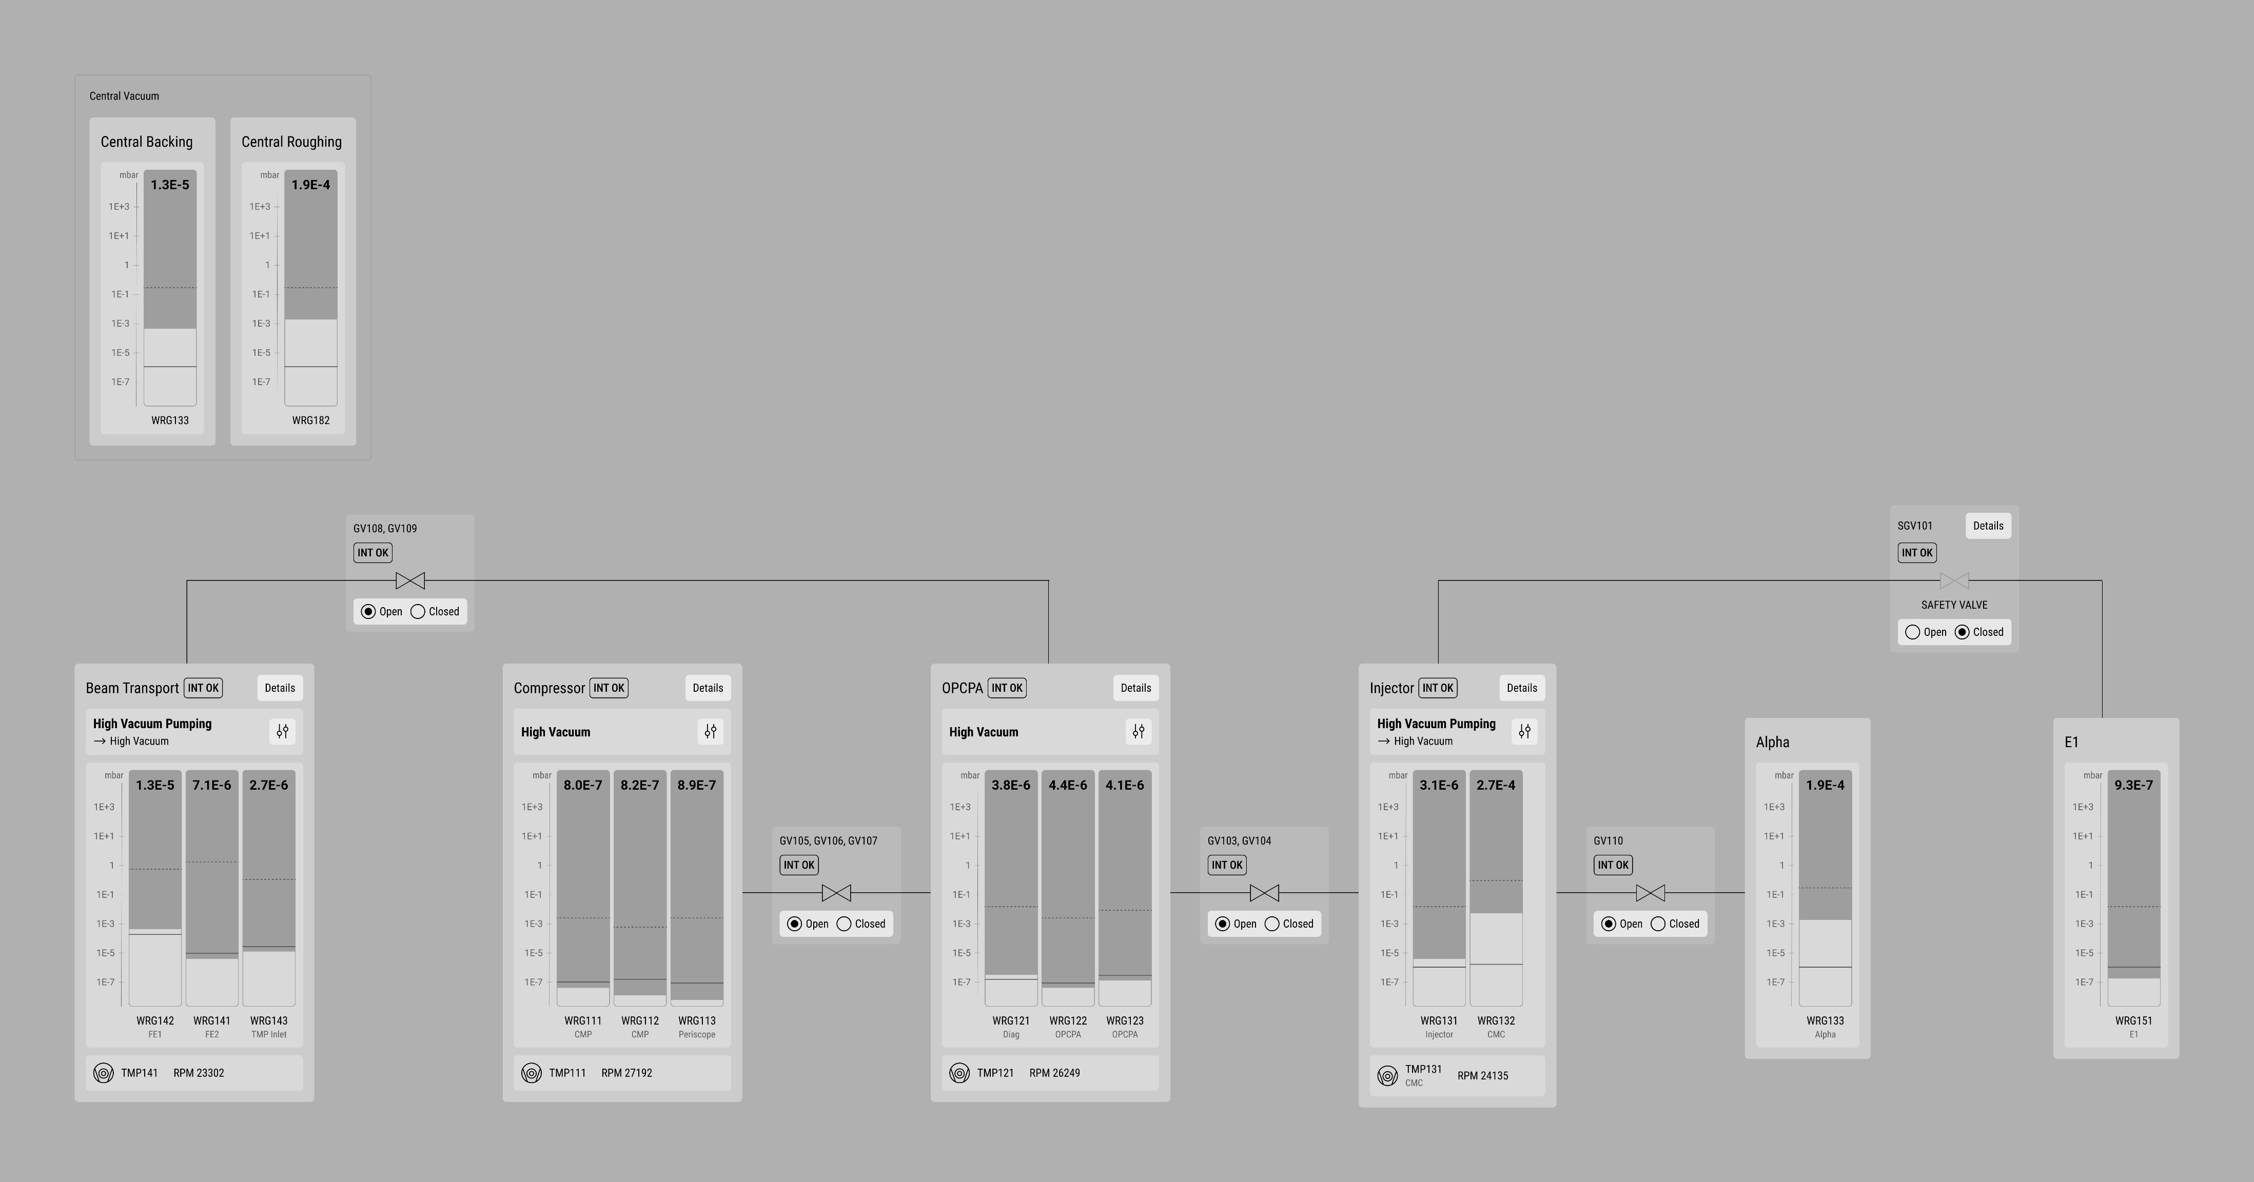
Examples

Slide 22
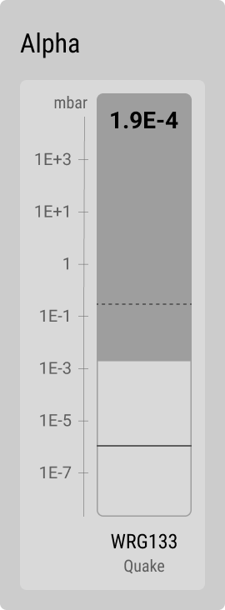
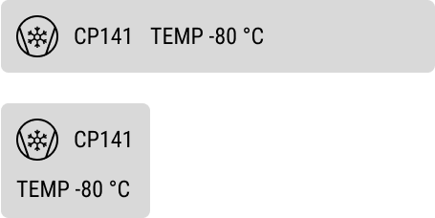
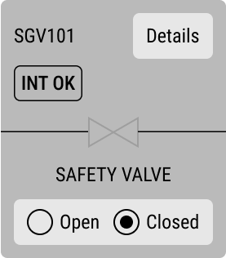
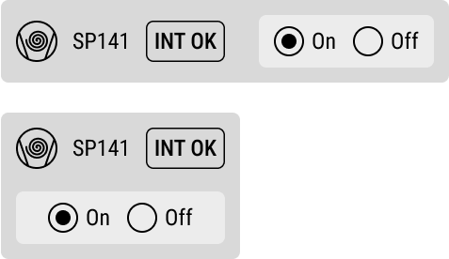
Examples

Slide 23
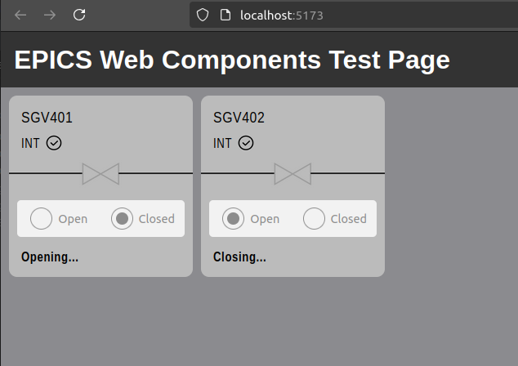
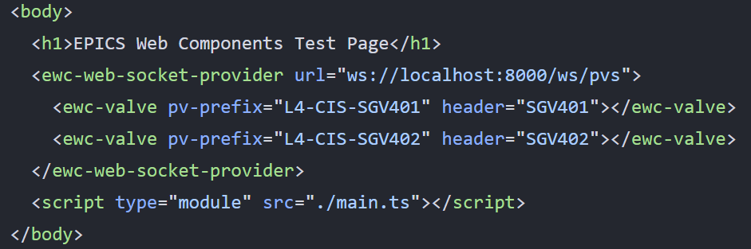
Examples

Slide 24
Future
Demo project
Server side services implementations
Web Components library
Complex client application

Slide 25
Conclusion
We still need to perform more load/stress tests
Hiring of the UX designer was a great choice – unified UI design
The design of new GUIs should always go through the UX designer
Implementation and deployment should then be very fast
Satisfied operators and less workload for technical support

Slide 26
Thank you for your attention!
Author: Jiří Švácha
Visit to Harwell Science and Innovation Campus, February 5–6, 2025

